Slide 1
Business Officers Forum
12/12/2024

Slide 2
Emergency Preparedness
July 30, 2018
Letter from Bishop Pates
Crisis mgmt. task force
Fr Ray McHenry
Another group led by John Quinn (Former DCI Director and Waukee police chief)
Bishops requirements for parishes:
All are to be weapon free zones
Exception is made for police offices but not retired police officers
No weapons signage on church doors
Retention of law enforcement for security at liturgies must have specific permission of bishop
Ushers have a key role, training, equipment
Entrance, exit doors to remain unlocked during liturgical gatherings
School plans are required by law and should all be in place.

Slide 3
Emergency Operations Plans
Bishop Joensen will require:
Every parish to have a plan in place by a certain date.
More focus church security and must include Religious Education activities

Slide 4
Catholic Mutual Guide
Helpful guide from Catholic Mutual on our website:
Website/Resources/Finance/Risk Management and Insurance/Parish Safety and Security guide
Very detailed and will walk you through the planning process.

Slide 5
Safety Committee
Every parish must have one.
Include:
Pastor
Parishioners
Ushers
Others as appropriate
Local Law Enforcement Authorities is always a great resource

Slide 6
Emergency Plan
Every parish must have one.
Emergency Plan provides authority
Who is responsible
Contact names/phone numbers

Slide 7
Potential Threats
Start by identifying and rating your potential threats:
Rural vs. urban parishes have different threats
Interstates could have accidents with hazardous materials
Rural could have anhydrous ammonia- fertilizer plant/distributor nearby
Natural disasters
Floods
Severe Weather
Tornados
Winter weather
blizzards
Fire

Slide 8
Unexpected Emergencies
Medical Emergencies
Fainting
Heart attacks
Choking
Intruders
Protestors
Mass interruptions
Active shooters

Slide 9
Include in your plan
Contingencies:
Services in the church
Mass
Other Services
Religious Ed.
Meetings

Slide 10
Items to Consider
Maps of exits
Doors with locks
Lockdown capabilities
Location of equipment/supplies
First aid kits
Flashlights
Weather radio
Fire extinguishers
Planning for
Evacuation
Shelter in place

Slide 11
Potential Training
Stop the bleed
Basic emergency first aid
AED
Run, Hide, Fight training

Slide 12
Other Items to Consider
If Mass is being broadcast
Turn cameras away
Media
Who talks to the Media
You can refer media to Diocese
How is in-charge to take actions
Annual Exercise to test the plan

Slide 13
Things to Remember
Every parish is different- don’t copy another’s plan
School and church planning is different
Schools have employees- who are there
Churches are working with volunteers- who aren’t always there
We sometimes rely on ushers – They may not be the best person for an emergency
Don’t always count on cell phones
Make sure to review your plans when you get a new pastors
Different police depts. have different ways of working with parishes
Meet with them
Review your plan with them
Understand what actions they will take with different emergencies
Understand what they are expecting you to do or have in place.

Slide 14
Dwight D. Eisenhower
“In preparing for battle, I have always found that plans are useless but planning is indispensable.”

Slide 15
Facility Usage
Goal here is to limit risk and prevent injuries, damage and lawsuits
These forms are being reviewed by CMG and our attorneys Website/Resources/Finance/Property Management and Security/Facility Usage Agreements
Trying to make this clearer and less complicated

Slide 16
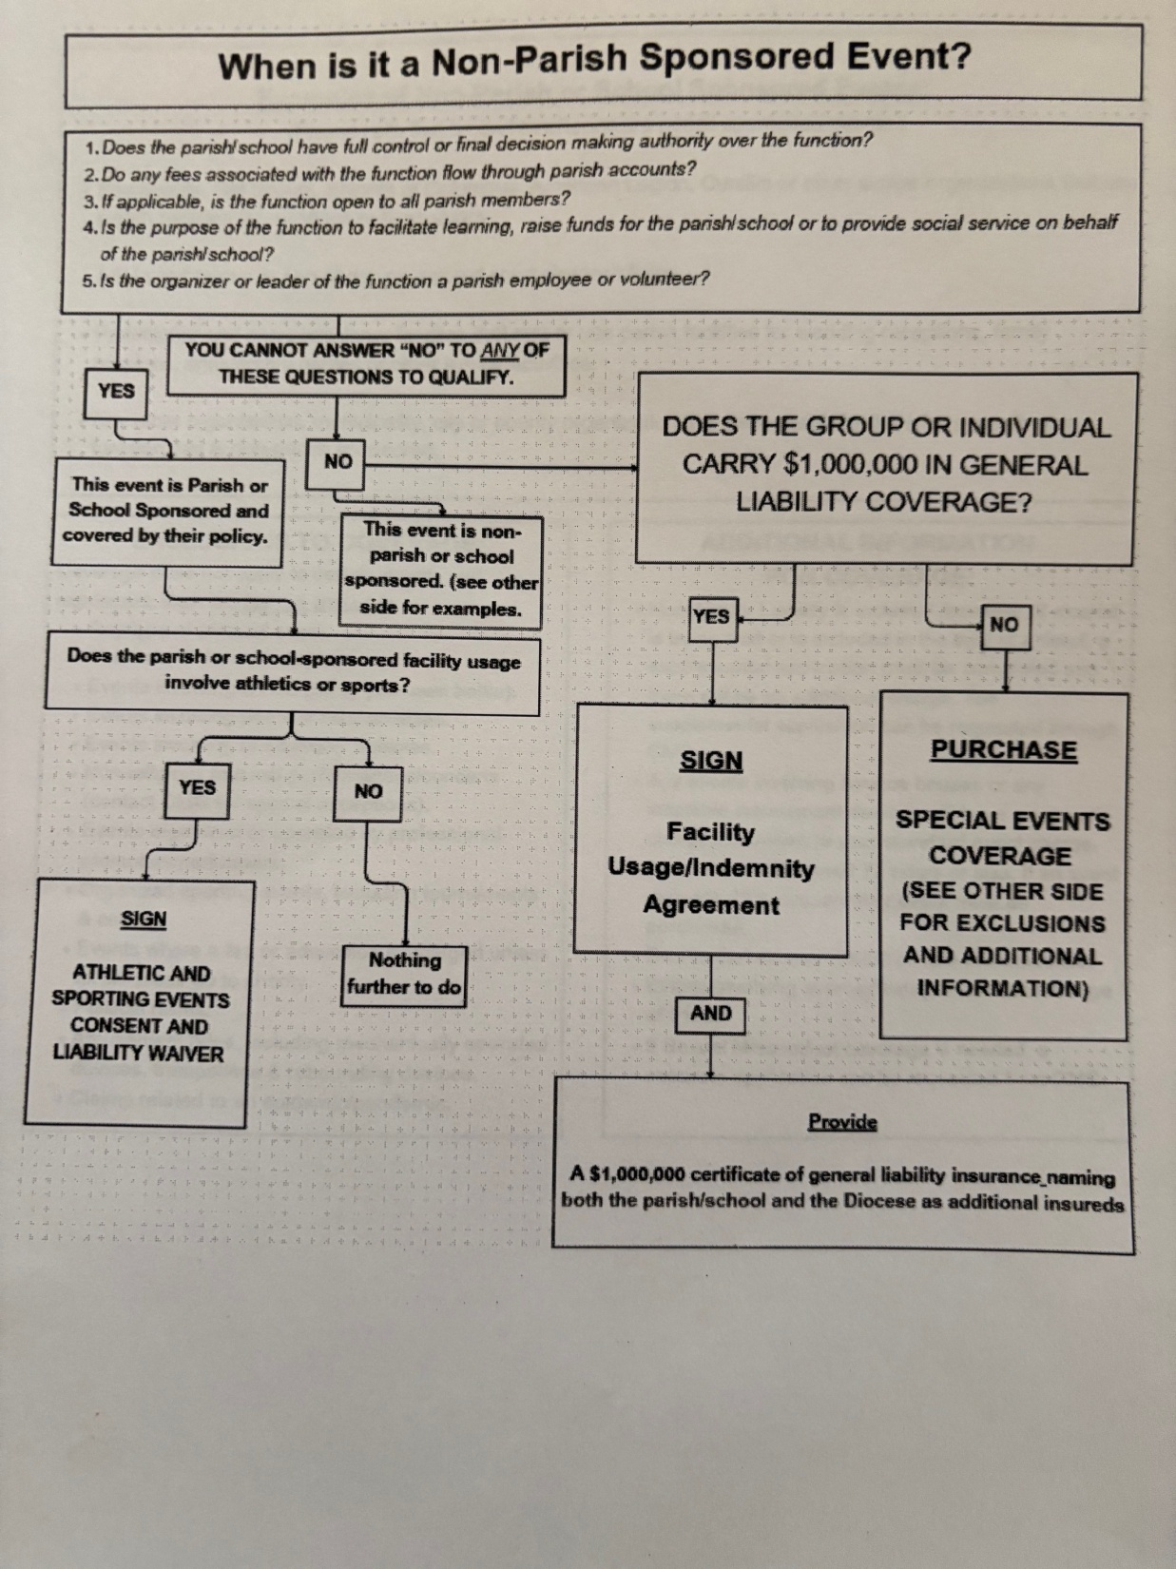

Slide 17
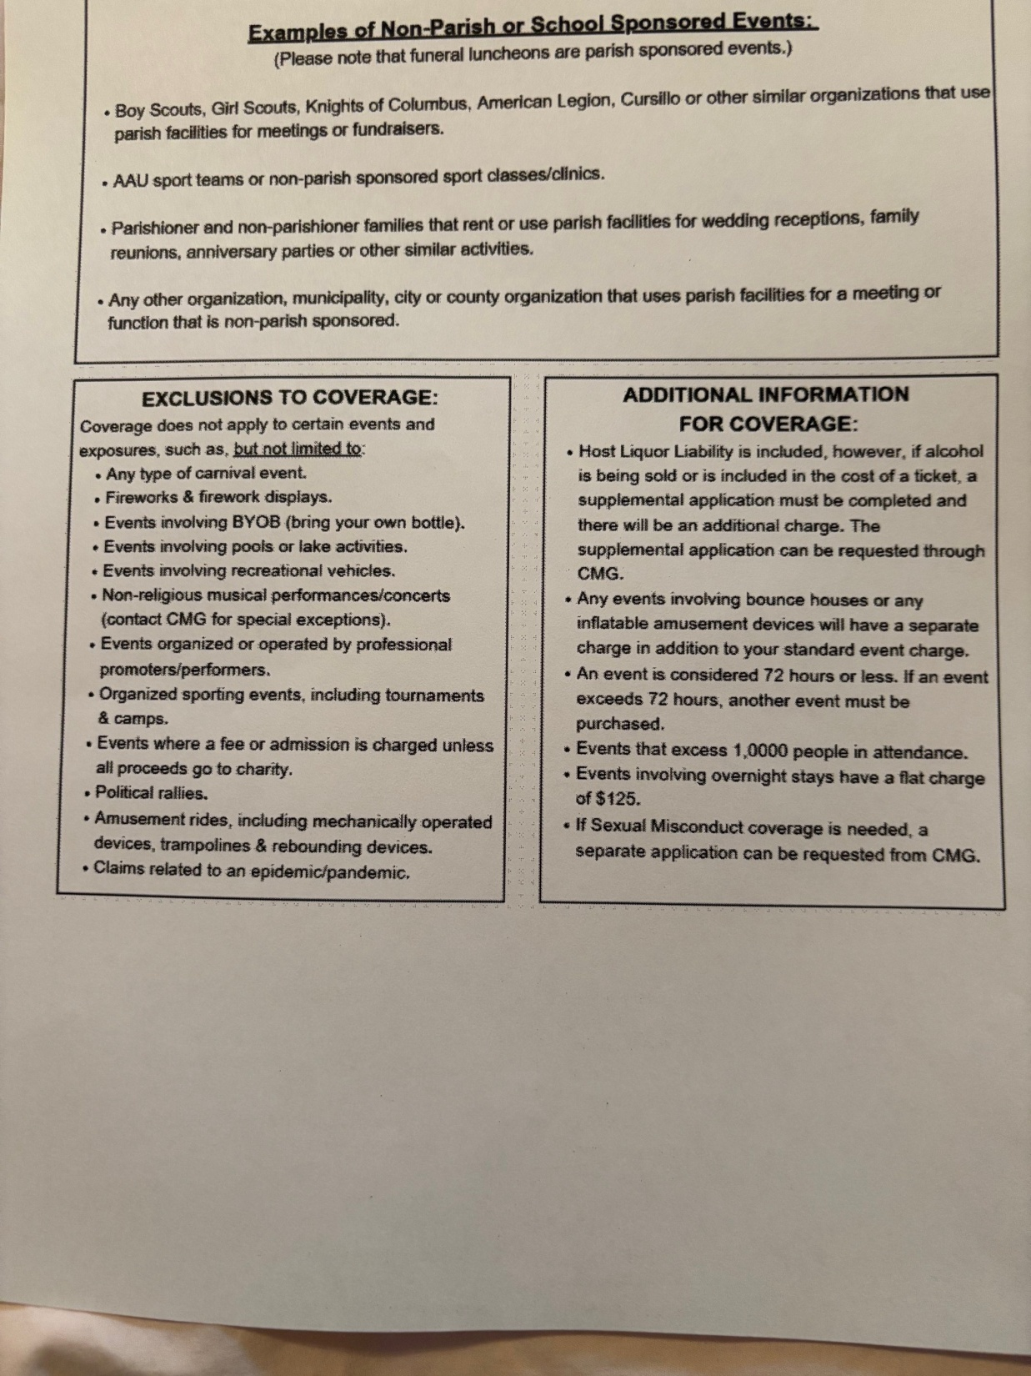

Slide 18
Parish Facility Inventory
What is the overall shape of your facility?
New form that we talked about previously
Website/resources/Finance/property management and security/parish large expense inventory survey

Slide 19
Building Inspection
Testing a Professional building consultant/inspector
Potential option for parishes to use to assess their facilities

Slide 20
Insurance Repair Contracts
Such as hail or wind damage claims
Some of these are very expensive
Going forward all contracts for these repairs need to be reviewed by Catholic Mutual and Norm.
Contact Norm for assistance

